Slide 1
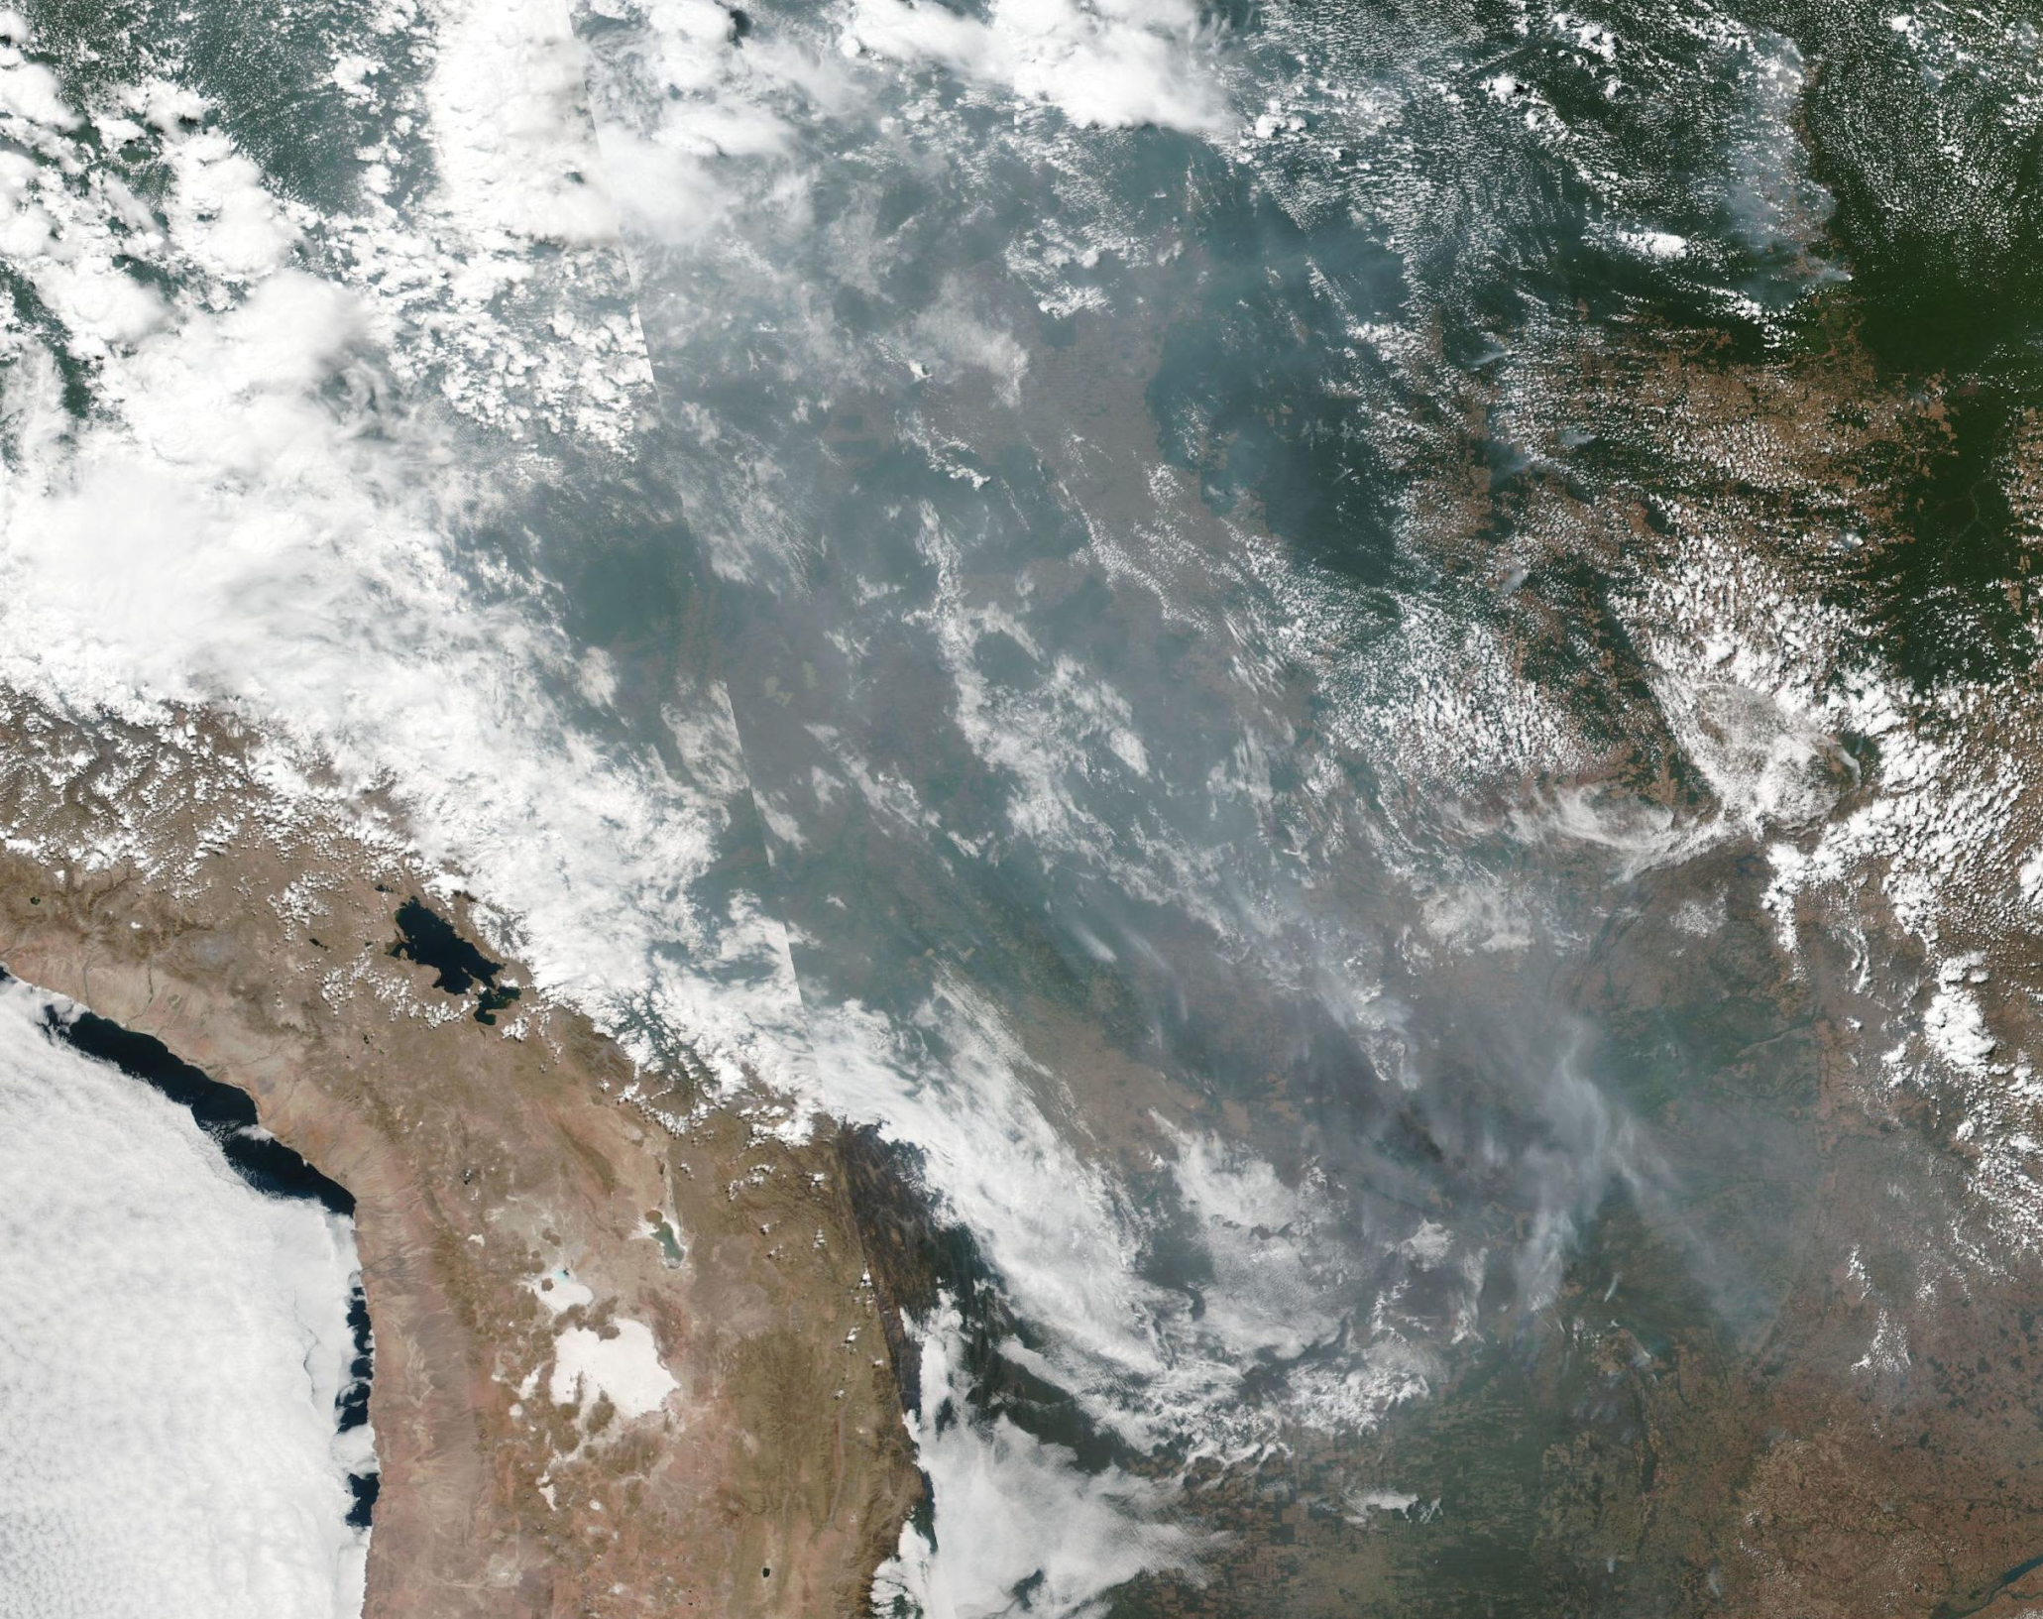
Amazon Rainforest Fire Forecasting
Team: Steve Hewitt, Chang Liu, Fernando Roriz, and Jose Torres

Slide 2
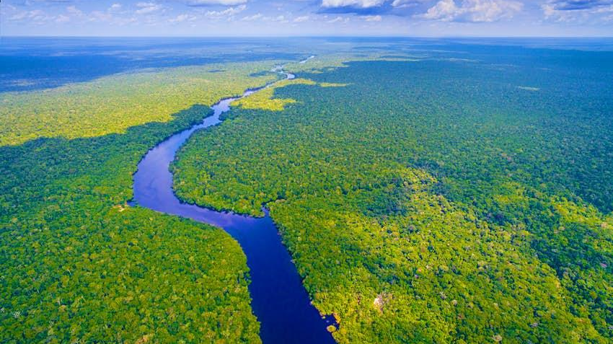
Motivation

Slide 3
Problem Statement
There are thousands of fires in the Amazon Rainforest that pose a threat to millions of animals and hundreds of indegenous tribes that depend on the Amazon to survive.
Lula (president elect of Brazil) promised to fight deforestation, grant protected status to 500,000 sq Km of the Amazon, subsidize sustainable farming, and reform the tax code to usher a greener economy.
Brazil vowed to halt deforestation by 2030.
In June 2022 the number of fires in the Amazon hit a 15 year high.
The destruction of tropical forests is responsible for approximately 9% of human caused CO2 emissions.

Slide 4


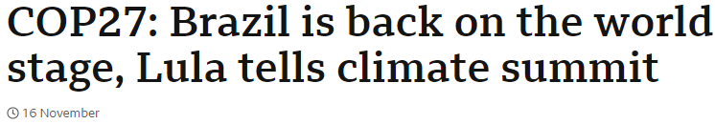
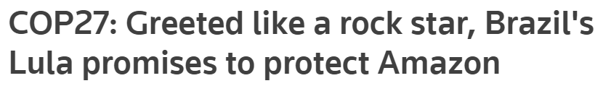


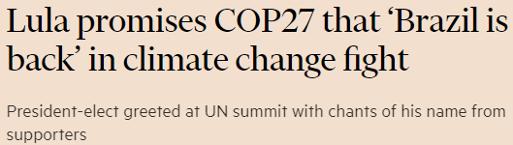
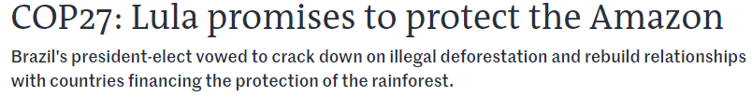
Brazil is crucial for climate change discussions

Slide 5
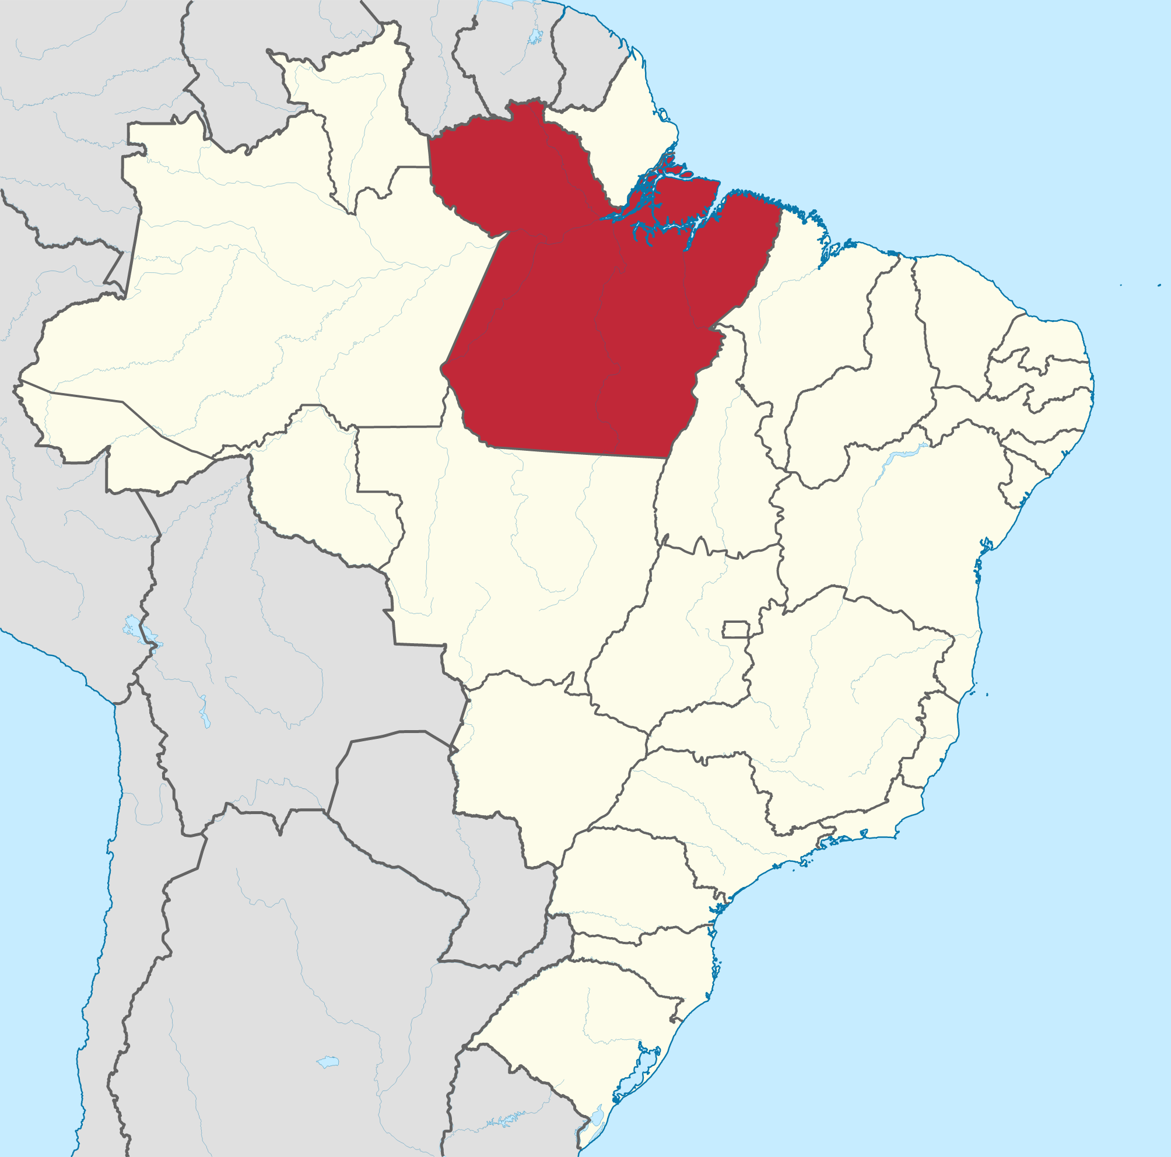
Project Overview
Question 1: “Given a recently deforested area,
can we predict if a fire will occur there
later in the same year?”
Question 2: “Once a fire begins anywhere in the rainforest, can we predict how it will spread?”
Pará

Slide 6
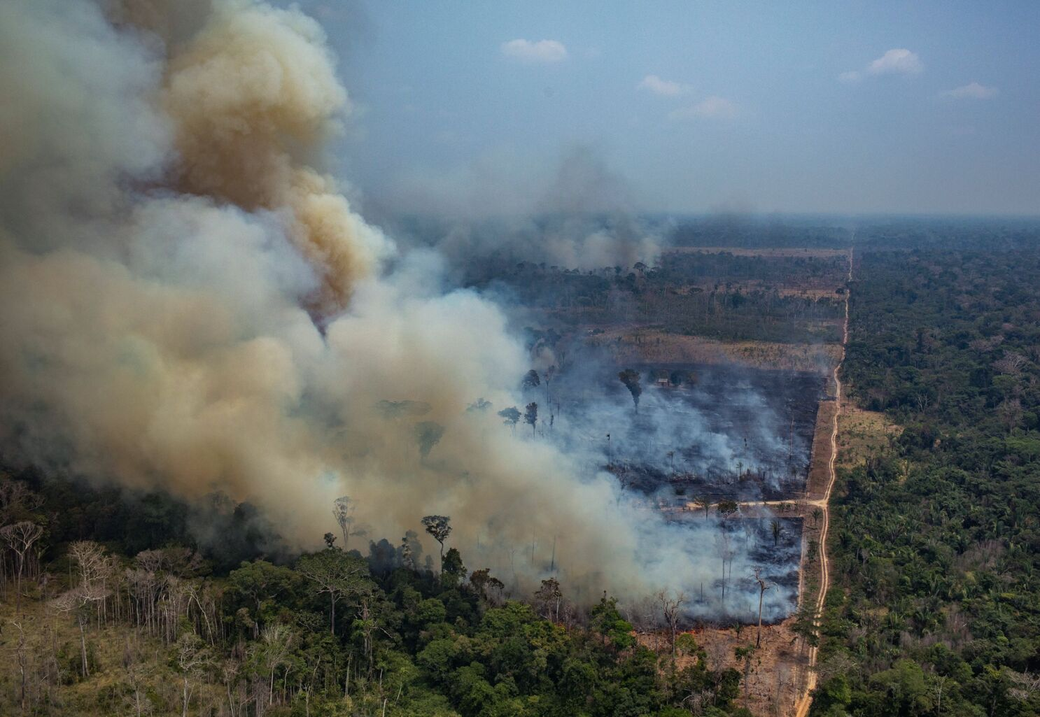
Linking Deforestation and Fires
Question 1: “Given a recently deforested area,
can we predict if a fire will occur there
later in the same year?”

Slide 7
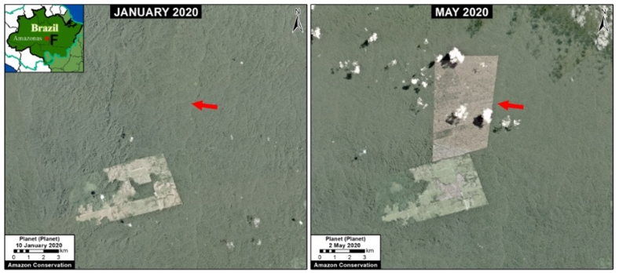
Deforestation often precedes forest fires

Slide 8
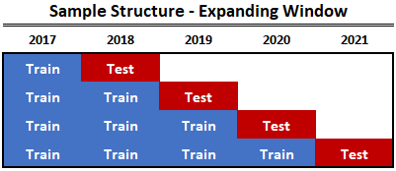
Predicting fires in a new deforested area
Fire_same_year = f(variables)
Variables: Deforested Area, Perimeter of the deforested area, Latitude, Longitude, Distance to the closest road, among others.
Model - KNN (10 Neighbors)
Important Model Feature:
Capture Clusters

Slide 9
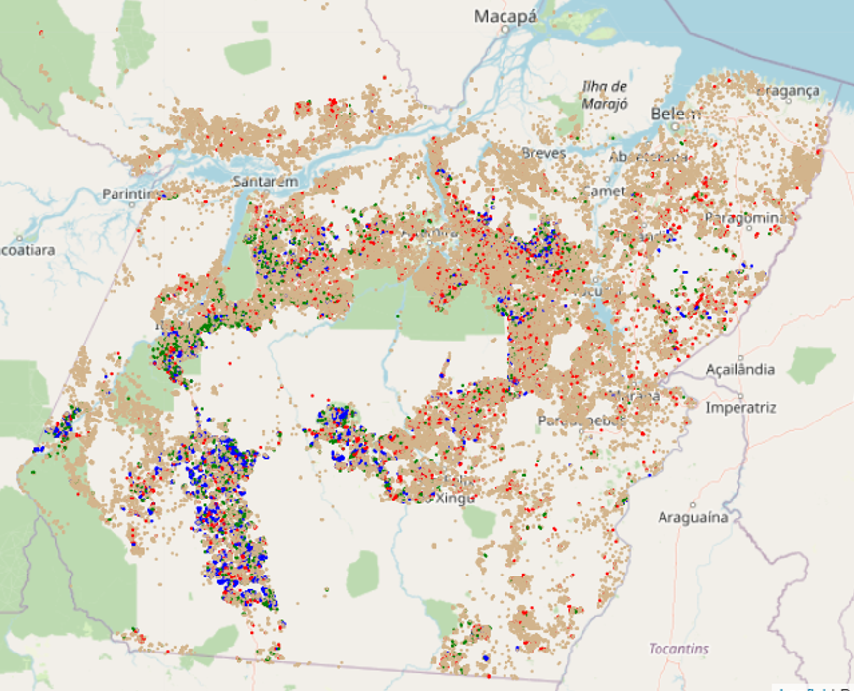
Model Prediction
P(Fire = True| Deforested = True)
Performance (by area):
Positive Predictive Value (PPV): 65%
Negative Predictive Value (NPV): 82%
True Positive Rate (Recall): 63%
False Positive Rate (FPR): 16%
Colormap Legend:
TP | FN
FP | TN

Slide 10
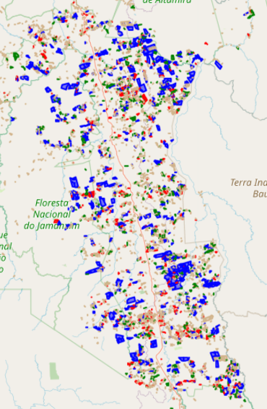
Fire Clusters
Areas marked in red are fire clusters and are usually concentrated near major roads.

Slide 11
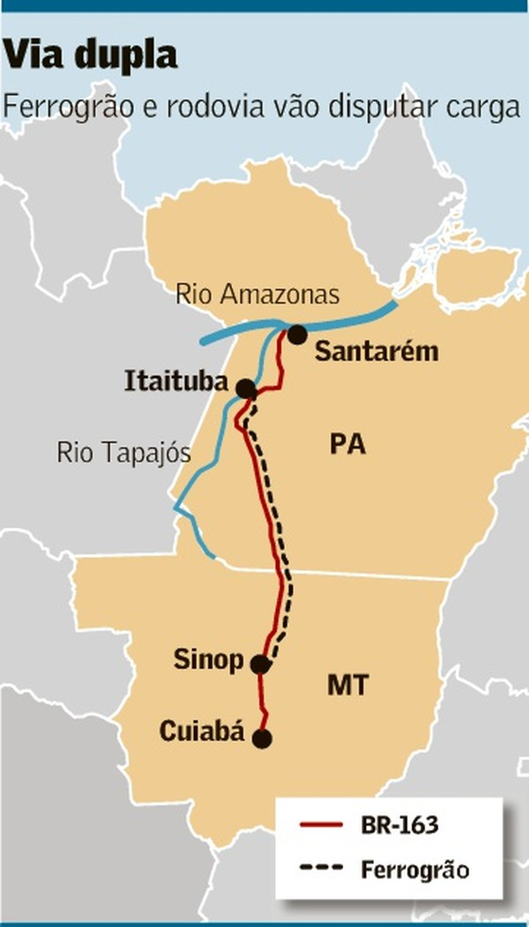
Fire Clusters
The largest fire cluster is closely related to the existence of a large highway and also a railroad

Slide 12
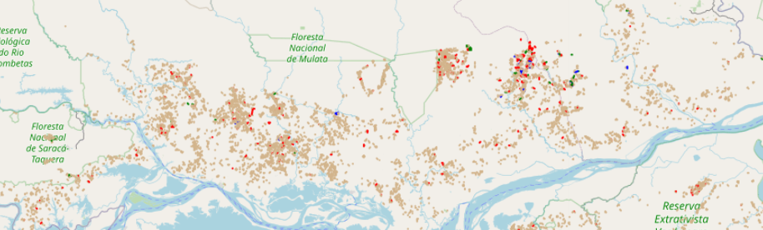
Deforestation and No Fire Areas
There are areas where we can see shadows of deforestation, but almost no fires.
Generally, these regions correspond to small areas of deforestation, where degradation occurs gradually.

Slide 13
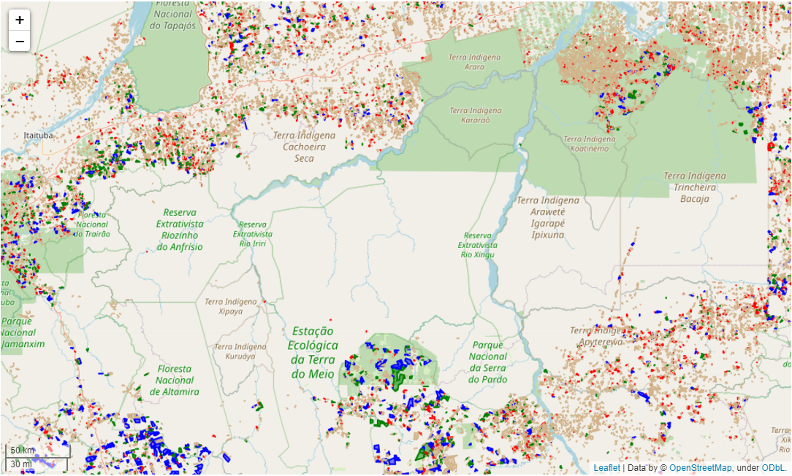
Legal Protection Areas
Legal protection areas are essential to maintain areas with almost no deforestation.

Slide 14
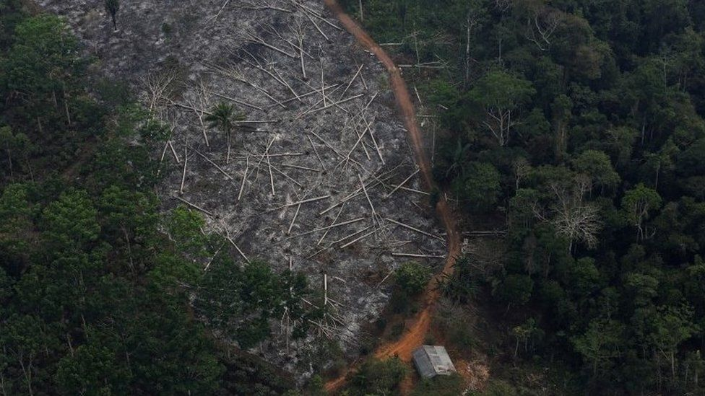
Datasets

Slide 15
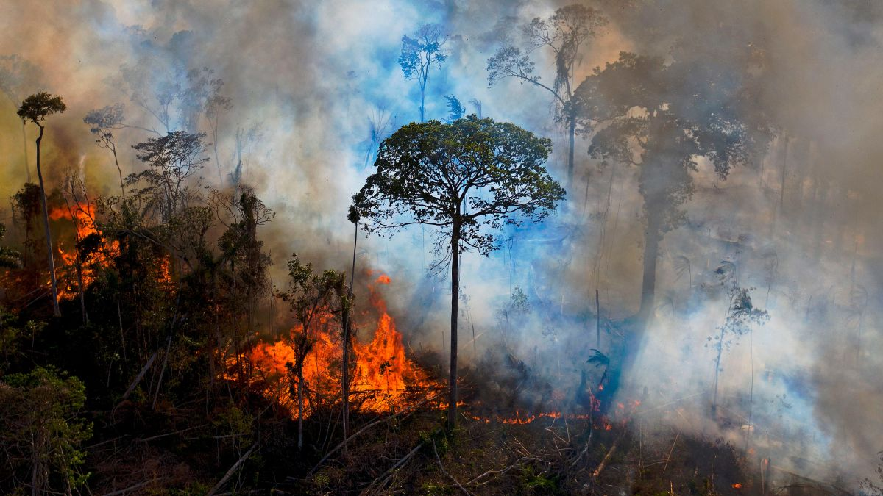
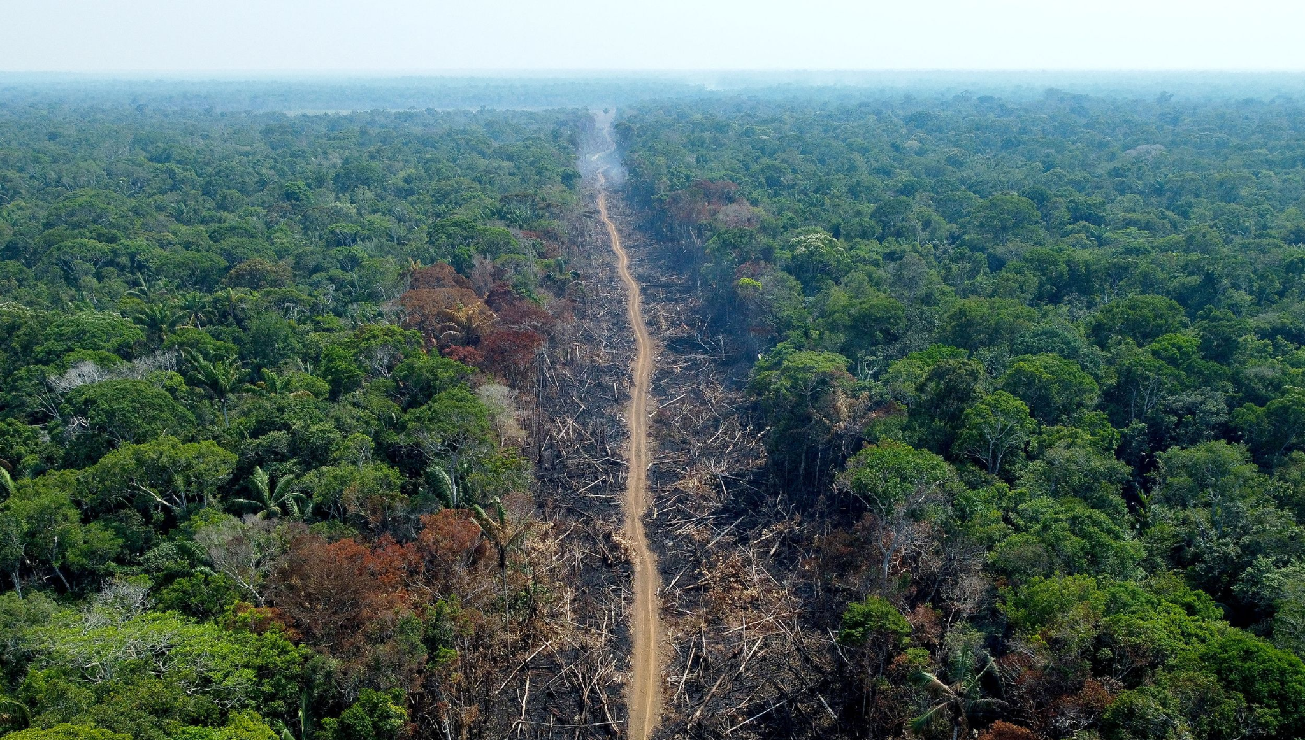
Datasets Used
Same datasets used for both models/questions.
Wildfire data: NASA Earth VIIRS (Visible Infrared Imaging Radiometer Suite) active fire data
Deforestation data: Terrabrasilis Deforestation data and shapefiles

Slide 16

NASA Earth VIIRS Data
Thermal anomalies / active fire data.
Captured from VIIRS sensor from Suomi National Polar-orbiting Partnership (Suomi NPP) and NOAA-20 satellites.
Complements Moderate Resolution Imaging Spectroradiometer (MODIS) fire detection.
Provides a greater response over fires of relatively small areas.
Also has improved nighttime performance.

Slide 17

TerraBrasilis Deforestation Data
Data on deforested areas in Brazil in time series.
Key features include lon, lat, state, date, polygon shape, satellite, deforestation classification, etc..
Goal is to see how many forest fire instances took place in deforestation areas based on geolocation information.

Slide 18
Forecasting Data Pipeline
Question 2: “Once a fire begins anywhere in the rainforest,
can we predict how it will spread?”

Slide 19
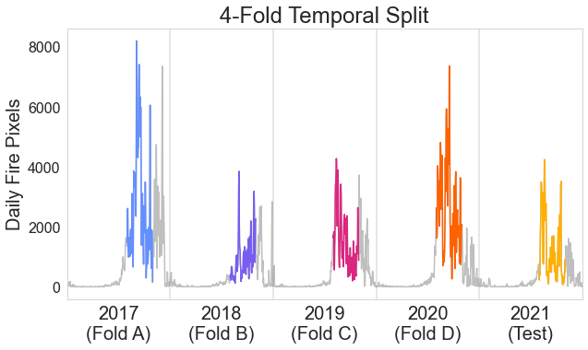
Targeted Data Filtering
Location Filtering
Pará

Slide 20

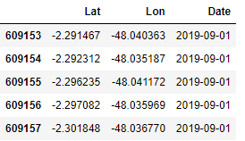

Fire Data Resampling and Transformations
Grid Size: 32x32 px, covering 12x12 km
Starting centroid pixel is sampled from VIIRS tabular data for each example.
1 Day Target Fire Grid
10 Daily Fire Grids Aligned, Resampled, & Stacked

Slide 21

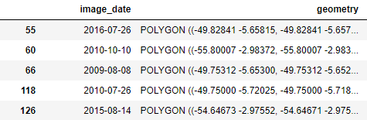
Deforestation Resampling and Transformations
Tabular Deforestation Data w/ Geo
Grid of Deforestation Prior to Fire (Stacked 10x)

Slide 22
Prediction Task
Given Video-Like Input:
Predict Next Day’s Fires:
1 Day Target Fire Grid
10 Daily Fire Grids
Deforestation Grid Stacked

Slide 23
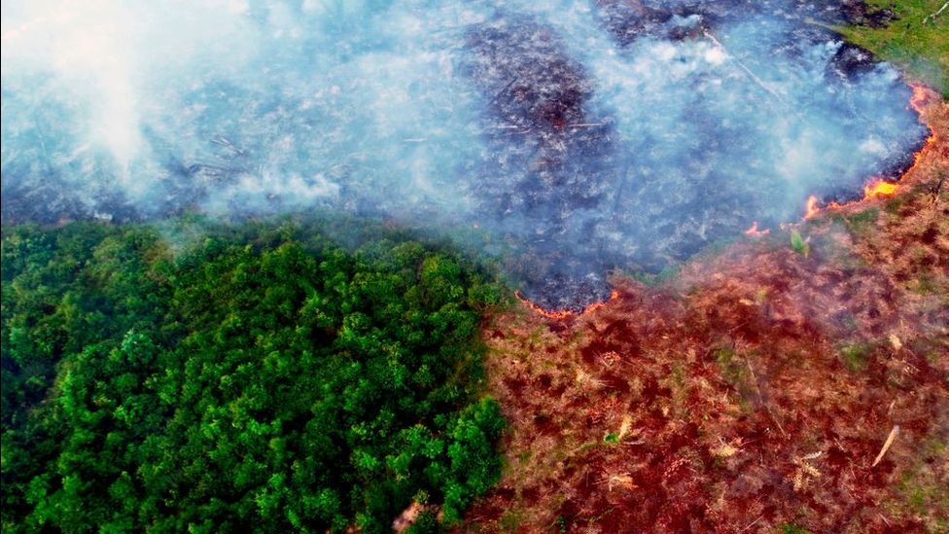
Forecasting Model and Metrics

Slide 24
Our Forecasting Models
Baseline Model
Final Model
Input
Input
Input: Video @ 1 frame per day.
Output: Next day prediction.
Built by chaining together multiple Convolutional LSTMs.
ConvLSTM layers combine recurrent connection of an LSTM with convolutional kernel of a CNN.
Final model used transfer learning approach and a simplified shape.
5x5 ConvLSTM + Batch Norm
5x5 ConvLSTM
3x3 ConvLSTM
+ Batch Norm
3x3 ConvLSTM
3x3 ConvLSTM
+ Batch Norm
1x1 ConvLSTM
1x1 ConvLSTM
1x1 Conv Output
1x1 Conv
Output

Slide 25
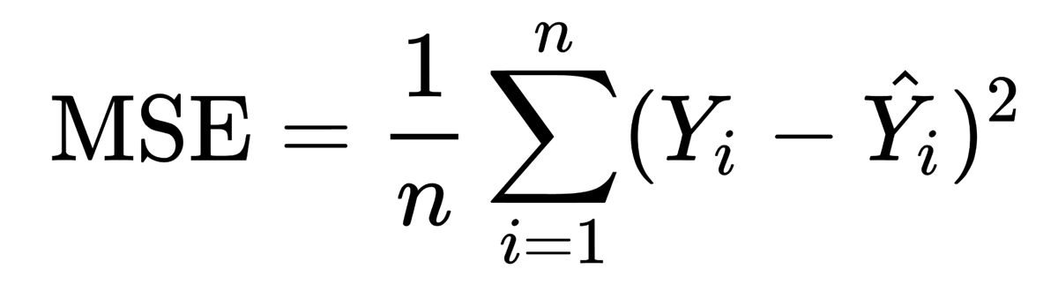
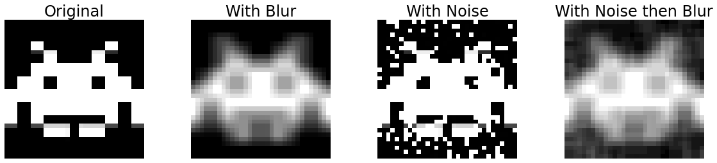
Evaluation Metrics (Comparing Target to Output)
Primary Metric Mean Squared Error (MSE):
MSE for our model spans from 0 to 1.
Supporting Metrics
Structural Similarity Index Measure (SSIM)
Perceived similarity of images.
Uses luminance, contrast, and structure.
Ranges from -1 to 1, 1 being perfect.
Peak Signal-to-Noise Ratio (PSNR)
Designed to grade image compression.
Ranges from 0 to 100, 100 being perfect.
SSIM: 0.41 PSNR: 11.5
SSIM: 0.77 PSNR: 9.9
SSIM: 0.35 PSNR: 10.5

Slide 26
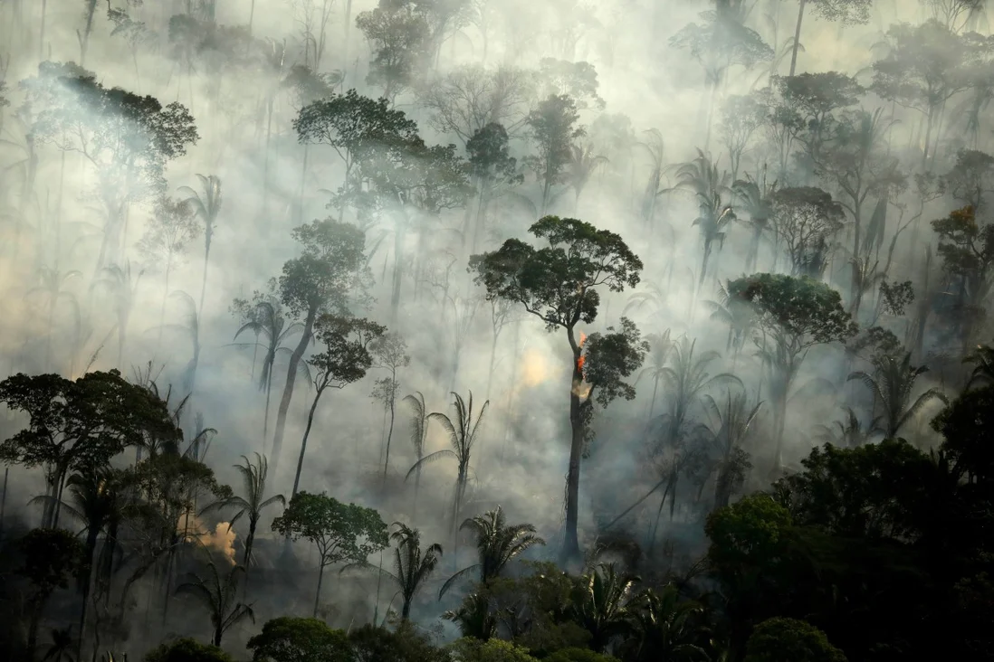
Forecasting Model Results

Slide 27
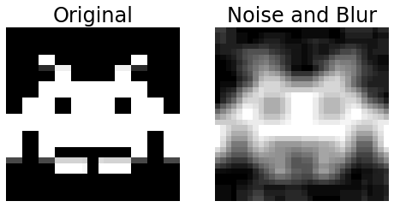
Baseline Results
Best early model results used fire and deforestation data as inputs.
WBCE loss helped with class imbalance.
Trained on 2017-2019 dataset.
Evaluated against 2020 dataset.
Baseline Metrics in Context
MSE | SSIM | PSNR
0.050 | 0.373 | 15.44
SSIM: 0.373 PSNR: 10.99

Slide 28

Model Adjustments
Procedure/Data Changes
Broadened scope of dataset from September data to include October, November and parts of August.
4-fold cross validation with each year 2017-2020 making up a fold.
Reduced the number of model parameters by removing one ConvLSTM layer and decreasing the number of filters.
Transfer learning
Pretrained on Moving MNIST.
Provided 90,000 clean 11 frame examples for our model to learn to encode/decode/predict motion.
Fine tuned on VIIRS data.
Had to drop deforestation data for transfer learning to work properly.

Slide 29
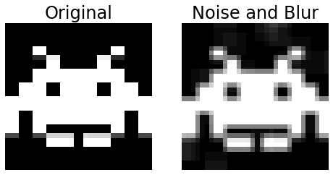
Final Results
Evaluated both models on 2021 test set.
Transfer Learning approach massively improved all metrics.
Dice loss used to encourage sharpness.
Final Metrics in Context
Model Version | MSE | SSIM | PSNR
Baseline | 0.042 | 0.334 | 16.09
Transfer Learning | 0.015 | 0.746 | 45.57
Change | -0.027 | 0.412 | 29.48
Change (%) | -64.5% | 123.4% | 183.3%
SSIM: 0.749 PSNR: 13.78

Slide 30
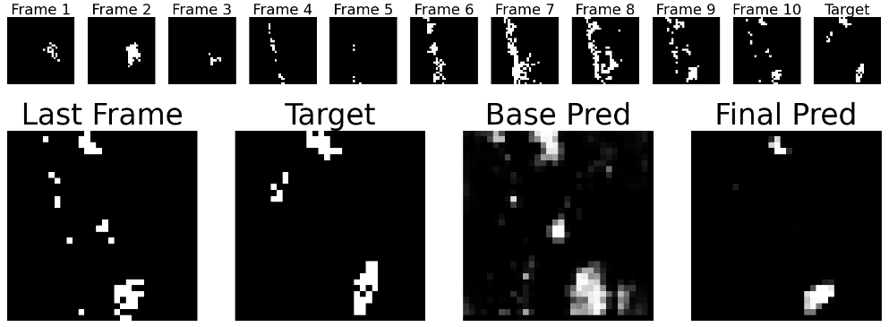
Examining a Good Prediction
SSIM: 0.24 PSNR: 13.7
SSIM: 0.63 PSNR: 15.0

Slide 31
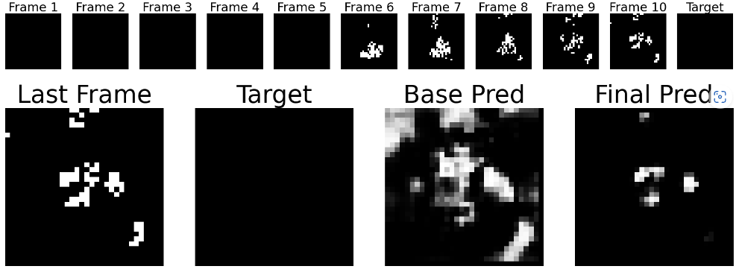
Examining a Bad Prediction
SSIM: 0.09 PSNR: 9.0
SSIM: 0.48 PSNR: 17.1

Slide 32
Metrics by Sample Group
Group | Base MSE | Final MSE | Base SSIM | Final SSIM | Base PSNR | Final PSNR
Large Fires | 0.098 | 0.056 | 0.202 | 0.478 | 10.69 | 13.51
Small Fires | 0.021 | 0.002 | 0.388 | 0.919 | 18.93 | 79.36
Fires that spread | 0.054 | 0.030 | 0.328 | 0.603 | 14.65 | 17.55
Fires that shrink | 0.040 | 0.013 | 0.334 | 0.803 | 16.31 | 57.64
Final model outperforms baseline in all metrics on all categories.

Slide 33
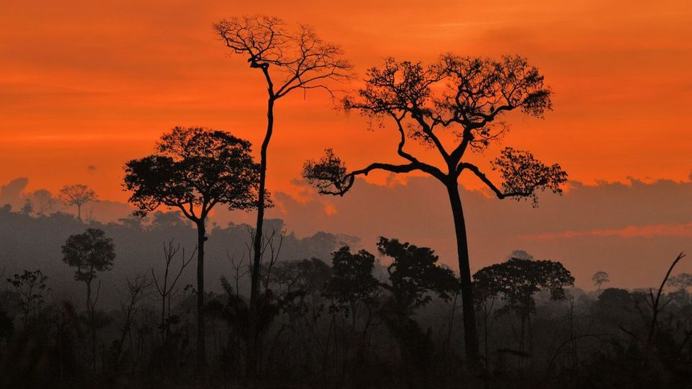
Any Questions?

Slide 34
References
https://www.earthdata.nasa.gov/learn/find-data/near-real-time/firms/viirs-i-band-375-m-active-fire-data
http://terrabrasilis.dpi.inpe.br/en/home-page/
https://www.earthdata.nasa.gov/learn/find-data/near-real-time/firms/about-firms
https://www.reuters.com/world/americas/causes-consequences-amazon-fires-deforestation-2022-08-10/
https://news.mongabay.com/2020/08/can-we-predict-where-amazon-fires-will-occur-and-to-what-end/#:~:text=Amazon%20fires%20are%20currently%20predicted,months%20of%20July%20through%20September
https://arxiv.org/pdf/1506.04214v1.pdf

Slide 35
References (Continued)
https://cnr.ncsu.edu/news/2019/09/amazon-rainforest-fires-everything-you-need-to-know/
https://www.reuters.com/business/cop/brazils-lula-put-climate-center-first-post-election-speech-abroad-2022-11-16/
https://www.bbc.com/news/science-environment-63625698
https://www.lemonde.fr/en/international/article/2022/11/16/cop27-lula-promises-to-protect-the-amazon_6004551_4.html
https://www.ft.com/content/b0985574-3342-41ca-a27e-5db9d0459069
da Silva, Richarde Marques, Aricson Garcia Lopes, and Celso Augusto Guimarães Santos. "Deforestation and fires in the Brazilian Amazon from 2001 to 2020: Impacts on rainfall variability and land surface temperature." Journal of Environmental Management 326 (2023): 116664

Slide 36
Image Credits
https://image.cnbcfm.com/api/v1/image/106092124-1566490026923brazilfiretuesday.jpg?v=1566491354
https://lp-cms-production.imgix.net/image_browser/shutterstockRF_1288634608.jpg?auto=format&fit=crop&sharp=10&vib=20&ixlib=react-8.6.4&w=850&q=75&dpr=1
https://ichef.bbci.co.uk/news/976/cpsprodpb/1CC4/production/_115746370_mediaitem115692680.jpg
https://ichef.bbci.co.uk/news/976/cpsprodpb/35E9/production/_119410831_untitled3.png
https://miro.medium.com/max/808/1*-e1QGatrODWpJkEwqP4Jyg.png

Slide 37
Image Credits (Continued)
https://img.i-scmp.com/cdn-cgi/image/fit=contain,width=1098,format=auto/sites/default/files/styles/1200x800/public/d8/images/methode/2020/05/09/8d0674dc-9198-11ea-a674-527cfdef49ee_image_hires_101728.jpg?itok=EmD1ViWa&v=1588990661
https://ca-times.brightspotcdn.com/dims4/default/18bac46/2147483647/strip/true/crop/2334x1610+0+0/resize/1200x828!/format/webp/quality/80/?url=https%3A%2F%2Fcalifornia-times-brightspot.s3.amazonaws.com%2Fc3%2F14%2Fbecef9834161962b5c22a3389564%2Fafp-getty-brazil-fire-deforestation-amazon2.JPG
https://www.nasa.gov/sites/default/files/thumbnails/image/nasa-logo-web-rgb.png
https://avatars.githubusercontent.com/u/38921410?s=280&v=4

